Slide 1


Myntra Analysis

Slide 2


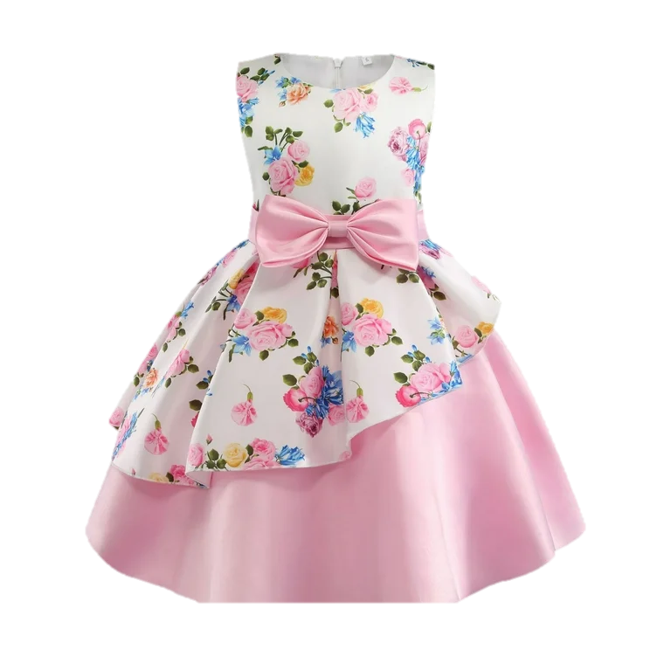


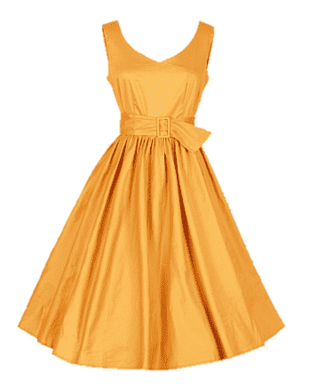
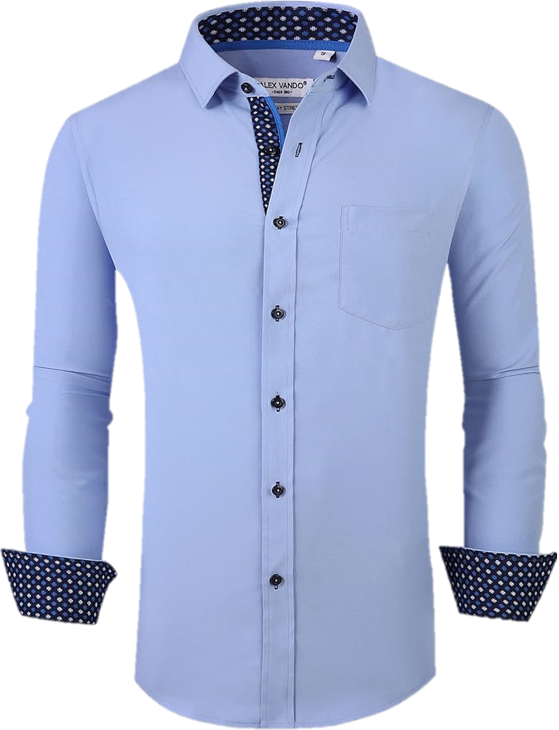
Introduction
Myntra is one of India’s largest online fashion and lifestyle e-commerce platforms.
It was founded in 2007 by Mukesh Bansai, Ashutosh Lawania, and Vinnet Saxena as a personalized gift portal before transitioning into the fashion retail space.
Myntra offers a vast selection of clothing, footwear, accessories, beauty products, and home decor for men, women, and children.
The platform features over 5,000 domestic and international brands. In 2014, Myntra was acquired by Flipkart, one of India’s largest e-commerce companies.

Slide 3



Introduction to Myntra
Reviews
Myntra Platform page
Social Media
Third-Party Review websites
App Stores
Discussion Forums
Social Media
Myntra leverages platforms like:
Instagram
Facebook
Twitter
You tube to engage with its audience.

Slide 4



Market Trends & Brand Perception
Market Trends
Increased Focus on Sustainability
Growth in Private Labels
Personalization and AI
Influencer and celebrity collaborations
Expansion of product categories
Brand perception
Fashion Authority
Convenience and user experience
Discounts and Deals
Brand Collaboration
Quality concerns
Customer Service
Sustainability efforts

Slide 5



Myntra Reviews
Google Review
Positive :
Many users appreciate Myntra for its wide variety of products, easy-to-use app, and good discounts.
Customers also commend the platform for providing experience, with a clean interface that makes shopping easy and enjoyable.
Negative :
However, there are numerous complaints related to customer service, delivery issues, and product quality.
Common negative experiences include receiving incorrect or damaged products, delayed refunds, and lack of responsiveness from customer support.
Some users have reported fraudulent activities, such as receiving products without price tags and having their returns denied due to these issues.
Facebook Review
Positive :
Customers often praise the variety of fashion products and regular discounts.
Many uses highlight the easy navigation of the app and the prompt delivery of orders.
Negative :
Common complaints include poor customer service, delayed refunds and issues with order refunds.
Some customers also reported receiving incorrect or defective products, with difficulties in getting replacements or refunds.

Slide 6

Online Shopping hashtags : #onlineshopping #fashion #onlineshop #shopping #style #onlinestore #online #instafashion #ootd #fashionblogger #onlineboutique #love #instagood #fashionista #instagram #shoppingonline #fashionstyle #sale #trending #shop #like #dress #follow #shoponline #accessories #handmade #clothing #bhfyp #smallbusiness #saree
Myntra Hashtags
Myntra hashtags : #myntra #amazon #flipkart #fashion #onlineshopping #india #myntrafashion #instagram #shopping #fashionblogger #instafashion #ootd #instagood #ajio #style #love #photography #model #sale #trending #amazonfashion #snapdeal #amazonindia #instadaily #fashionstyle #paytm #amazondeals #indianfashion #saree #indianwear
Fashion hashtags : #fashion #style #love #instagood #photography #like #beautiful #photooftheday #instagram #model #follow #ootd #fashionstyle #beauty #art #fashionblogger #picoftheday #moda #fashionista #instadaily #bhfyp #happy #instafashion #cute #likeforlikes #followme #shopping #smile #makeup #instalike

Slide 7

Customer Sentiment Analysis
Positive Sentiment
Reviews or posts with positive sentiment reflect customer satisfaction and appreciation. Customers praise product quality, timely delivery, customer support, and their overall shopping experience.
Neutral Sentiment
Neutral Feedback indicates that customers had an average or acceptable experience. The feedback is often balanced, neither strongly positive nor strongly negative. It might also contain suggestions for improvement.
Negative Sentiment
Negative feedback reflects customer dissatisfaction, usually due to issues with product quality, delivery, customer service, or overall experience. These reviews often highlight frustrations or problems customers encountered during their shopping journey.

Slide 8

Myntra Services
Myntra Services
Myntra Services
Product Quality
Inventory Management
Stock Availability
Product Assortment
Delivery Service
Delivery Time
Tracking
Delivery Issues
Customer Service
Support Channels
Response Time
Issue Resolution
Customer Service Quality
Product Quality
Inventory Management
Stock Availability
Product Assortment
Delivery Service
Delivery Time
Tracking
Delivery Issues
Customer Service
Support Channels
Response Time
Issue Resolution
Customer Service Quality

Slide 9
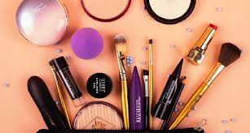
Myntra Extract customer reviews
Customer Reviews
Myntra Product Pages
Reviews are available under individual product listing on the Myntra Website/app.
Social Media Platforms
Search for customer feedback on Twitter, Instagram and Facebook using relevant hashtags like #MyntraReviews.
Third-Party Review Sites
Platforms like Trustpilot, Site Jabber, and Google Reviews aggregate user feedback on overall shopping experiences.
E-commerce Forums
E Sites like Mouth shut and Reddit often feature customers discussions and detailed reviews

Slide 10

Descriptors and Sentiments
Sentiments
Positive Sentiment
Satisfaction
Quality
Customer services
Negative Sentiment
Delivery Issues
Product Quality
Customer Service
Sentiments
Positive Sentiment
Satisfaction
Quality
Customer services
Negative Sentiment
Delivery Issues
Product Quality
Customer Service
Sentiments
Positive Sentiment
Satisfaction
Quality
Customer services
Negative Sentiment
Delivery Issues
Product Quality
Customer Service
Descriptors
Trendy
Varied
Convenient
Discounted
Reliable

Slide 11

Product Quality Sentiment
Availability of
Stock
Bulk Purchase Offers
Stock Shortages
Inaccurate Stock Information
Product Quality Positive
Product Quality Negative
Easy Quantity Adjustments
Low Stock Alerts
Pricing Changes Based on Quantity
Slow Restocking

Slide 12

Delivery Speed Sentiment
Delivery Speed Positive
Fast Delivery Options
On-Time Delivery
Real-Time Delivery Tracking
Flexibility in Delivery Times
Express Delivery During Sales or Festive Seasons
Delivery Speed Negative
Delayed Deliveries
Inconsistent Delivery Speed
Lack of Communication on Delays
High Costs for Faster Delivery
Poor Handling of Remote or Rural Deliveries
Missed Delivery Dates During Special Occasions
Delivery Speed Positive
Fast Delivery Options
On-Time Delivery
Real-Time Delivery Tracking
Flexibility in Delivery Times
Express Delivery During Sales or Festive Seasons
Delivery Speed Negative
Delayed Deliveries
Inconsistent Delivery Speed
Lack of Communication on Delays
High Costs for Faster Delivery
Poor Handling of Remote or Rural Deliveries
Missed Delivery Dates During Special Occasions
Fast Delivery Options
On-Time Delivery
Real-Time Delivery Tracking
Flexibility in Delivery Times
Express Delivery During Sales or Festive Seasons
Delayed Deliveries
Inconsistent Delivery Speed
Lack of Communication on Delays
High Costs for Faster Delivery
Poor Handling of Remote or Rural Deliveries
Missed Delivery Dates During Special Occasions
Delivery Speed Positive
Delivery Speed Negative
Delivery Speed Positive
Fast Delivery Options
On-Time Delivery
Real-Time Delivery Tracking
Flexibility in Delivery Times
Express Delivery During Sales or Festive Seasons

Slide 13

Market Trends Identification
Myntra’s On-Site Features
Social Media Insights
Sales and Events
Customer Reviews and Ratings
External Tolls and Platforms
Myntra Studio
User-Generated Content

Slide 14

Competitive Landscape
Competitive Analysis
Amazon Fashion
Flipkart Fashion
AJIO
Tata CLiQ
Nykaa Fashion

Slide 15

Competitive Landscape
User-Friendly Interface
Exclusive Brand Collections
Fast Delivery
Appealing Promotions and Sales
Trend-Focused
Customer Service Complains
Product Quality Issues
Packaging Concerns
Return Process Challenges
Delivery Delays in Some Regions
User-Friendly Interface
Exclusive Brand Collections
Fast Delivery
Appealing Promotions and Sales
Trend-Focused
Customer Service Complains
Product Quality Issues
Packaging Concerns
Return Process Challenges
Delivery Delays in Some Regions
Strength
Weakness

Slide 16
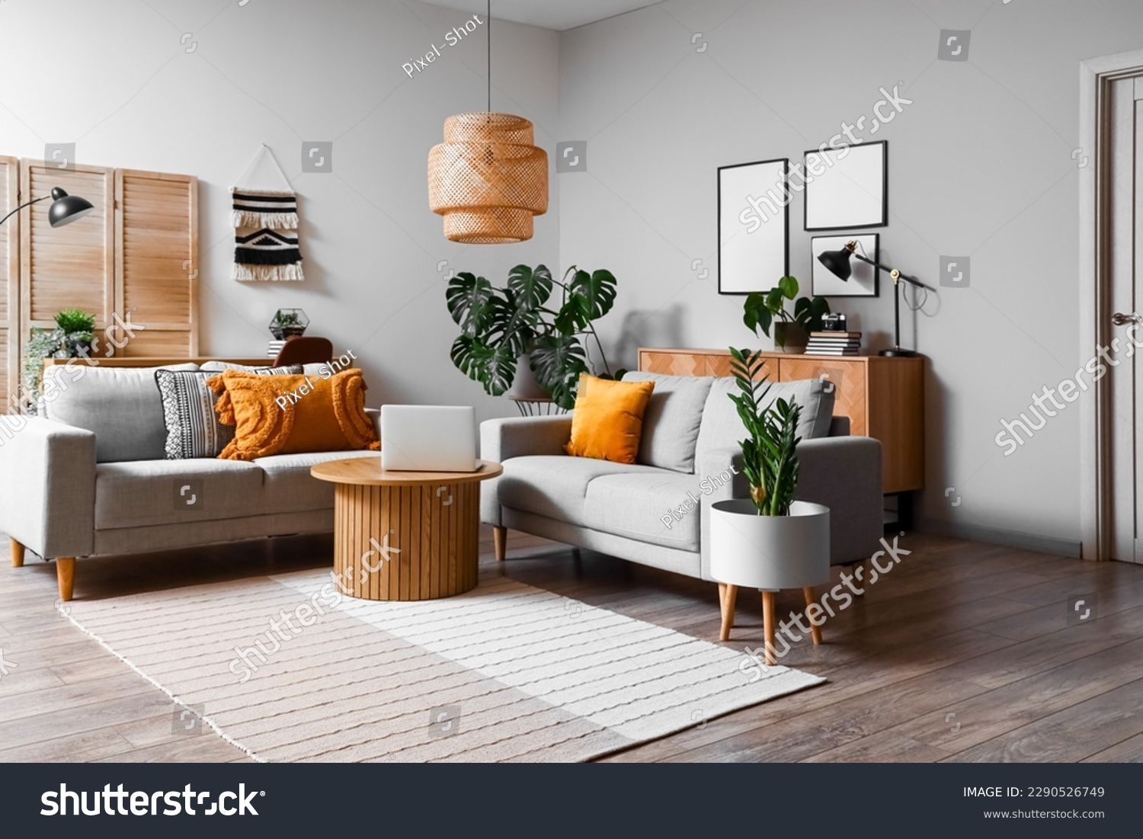
Strategic Recommendations
Customer Satisfaction
Improved Customer Service
Transparent and Hassle-Free Returns
Quality Assurance Programs
Loyalty and Reward Programs
Product Offerings
Sustainability and Ethical Fashion
Exclusive Collaborations and limited Editions
Expansion into New Categories
Enhanced Size Inclusivity
Marketing Strategies
Social Commerce and Influencer Partnerships
Omnichannel Marketing Campaigns
User-Generated Content (UGC) Campaigns
Content-Driven Marketing

Slide 17



